Slide 1
School of Computing Science and Engineering
Course Code: BCSE2350 Course Name: Cryptographic Fundamental
Message Authentication

Slide 2
Message Authentication
message authentication is concerned with:
protecting the integrity of a message
validating identity of originator
non-repudiation of origin (dispute resolution)
will consider the security requirements
then three alternative functions used:
message encryption
message authentication code (MAC)
hash function
Notes:
Up untill now, have been concerned with protecting message content (ie secrecy) by encrypting the message. Will now consider how to protect message integrity (ie protection from modification), as well as confirming the identity of the sender. Generically this is the problem of message authentication, and in eCommerce applications is arguably more important than secrecy. Message Authentication is concerned with: protecting the integrity of a message, validating identity of originator, & non-repudiation of origin (dispute resolution). There are three types of functions that may be used to produce an authenticator: message encryption, message authentication code (MAC), or a hash function.

Slide 3
Security Requirements
disclosure
traffic analysis
masquerade
content modification
sequence modification
timing modification
source repudiation
destination repudiation
Notes:
In the context of communications across a network, the attacks listed above can be identified.
The first two requirements belong in the realm of message confidentiality, and are handled using the encryption techniques already discussed.
The remaining requirements belong in the realm of message authentication. At its core this addresses the issue of ensuring that a message comes from the alleged source and has not been altered. It may also address sequencing and timeliness. The use of a digital signature can also address issues of repudiation by the source.

Slide 4
Message Encryption
message encryption by itself also provides a measure of authentication
if symmetric encryption is used then:
receiver know sender must have created it
since only sender and receiver now key used
know content cannot of been altered
if message has suitable structure, redundancy or a checksum to detect any changes
Notes:
Message encryption by itself can provide a measure of authentication. Here, the ciphertext of the entire message serves as its authenticator, on the basis that only those who know the appropriate keys could have validly encrypted the message. This is provided you can recognize a valid message (ie if the message has suitable structure such as redundancy or a checksum to detect any changes).

Slide 5
Message Encryption
if public-key encryption is used:
encryption provides no confidence of sender
since anyone potentially knows public-key
however if
sender signs message using their private-key
then encrypts with recipients public key
have both secrecy and authentication
again need to recognize corrupted messages
but at cost of two public-key uses on message
Notes:
With public-key techniques, can get a digital signature which can only have been created by key owner. But at cost of two public-key operations at each end on message.

Slide 6
Message Authentication Code (MAC)
generated by an algorithm that creates a small fixed-sized block
depending on both message and some key
like encryption though need not be reversible
appended to message as a signature
receiver performs same computation on message and checks it matches the MAC
provides assurance that message is unaltered and comes from sender
Notes:
An alternative authentication technique involves the use of a secret key to generate a small fixed-size block of data, known as a cryptographic checksum or MAC that is appended to the message. This technique assumes that two communicating parties, say A and B, share a common secret key K. A MAC function is similar to encryption, except that the MAC algorithm need not be reversible, as it must for decryption.

Slide 7
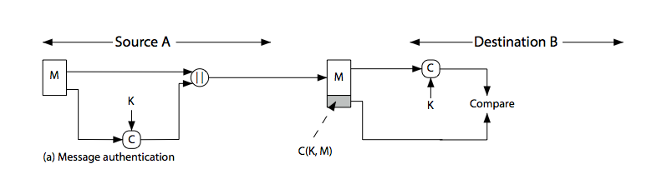
Message Authentication Code
Notes:
Stallings Figure 11.4a “Message Authentication” shows the use of a MAC just for authentication.

Slide 8
Message Authentication Codes
as shown the MAC provides authentication
can also use encryption for secrecy
generally use separate keys for each
can compute MAC either before or after encryption
is generally regarded as better done before
why use a MAC?
sometimes only authentication is needed
sometimes need authentication to persist longer than the encryption (eg. archival use)
note that a MAC is not a digital signature
Notes:
Can combine use of MAC with encryption in various ways to provide both authentication & secrecy.
Use MAC in circumstances where just authentication is needed (or needs to be kept), see text for examples.
A MAC is NOT a digital signature since both sender & receiver share key and could create it.

Slide 9
MAC Properties
a MAC is a cryptographic checksum
MAC = C_{K}(M)
condenses a variable-length message M
using a secret key K
to a fixed-sized authenticator
is a many-to-one function
potentially many messages have same MAC
but finding these needs to be very difficult
Notes:
A MAC, also known as a cryptographic checksum,is generated by a function C. The MAC is appended to the message at the source at a time when the message is assumed or known to be correct. The receiver authenticates that message by re-computing the MAC.
The MAC function is a many-to-one function, since potentially many arbitrarily long messages can be condensed to the same summary value, but don’t want finding them to be easy!

Slide 10
Requirements for MACs
taking into account the types of attacks
need the MAC to satisfy the following:
knowing a message and MAC, is infeasible to find another message with same MAC
MACs should be uniformly distributed
MAC should depend equally on all bits of the message
Notes:
In assessing the security of a MAC function, we need to consider the types of attacks that may be mounted against it. Hence it needs to satisfy the listed requirements.
The first requirement deals with message replacement attacks, in which an opponent is able to construct a new message to match a given MAC, even though the opponent does not know and does not learn the key.
The second requirement deals with the need to thwart a brute-force attack based on chosen plaintext.
The final requirement dictates that the authentication algorithm should not be weaker with respect to certain parts or bits of the message than others.

Slide 11
Using Symmetric Ciphers for MACs
can use any block cipher chaining mode and use final block as a MAC
Data Authentication Algorithm (DAA) is a widely used MAC based on DES-CBC
using IV=0 and zero-pad of final block
encrypt message using DES in CBC mode
and send just the final block as the MAC
or the leftmost M bits (16≤M≤64) of final block
but final MAC is now too small for security
Notes:
Can also use block cipher chaining modes to create a separate authenticator, by just sending the last block. This was done with the Data Authentication Algorithm (DAA), a widely used MAC based on DES-CBC (next slide). However this suffers from being too small for acceptable use today.

Slide 12
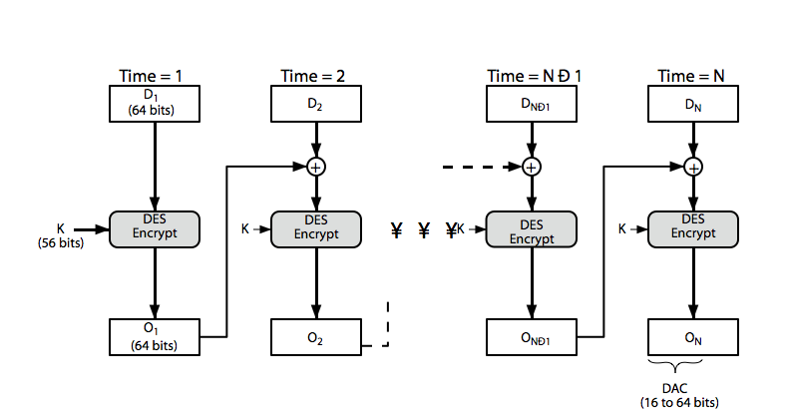
Data Authentication Algorithm
Notes:
Stallings Figure 11.6 “Data Authentication Algorithm”, illustrates the FIPS PUB 113 / ANSI X9.17 MAC based on DES-CBC with IV 0 and 0-pad of the final block if needed. Resulting MAC can be 16-64 bits of the final block. But this is now too small for security.

Slide 13
Summary
have considered:
message authentication using
message encryption
MACs
Notes:
Chapter 11 summary.

